Slide 1
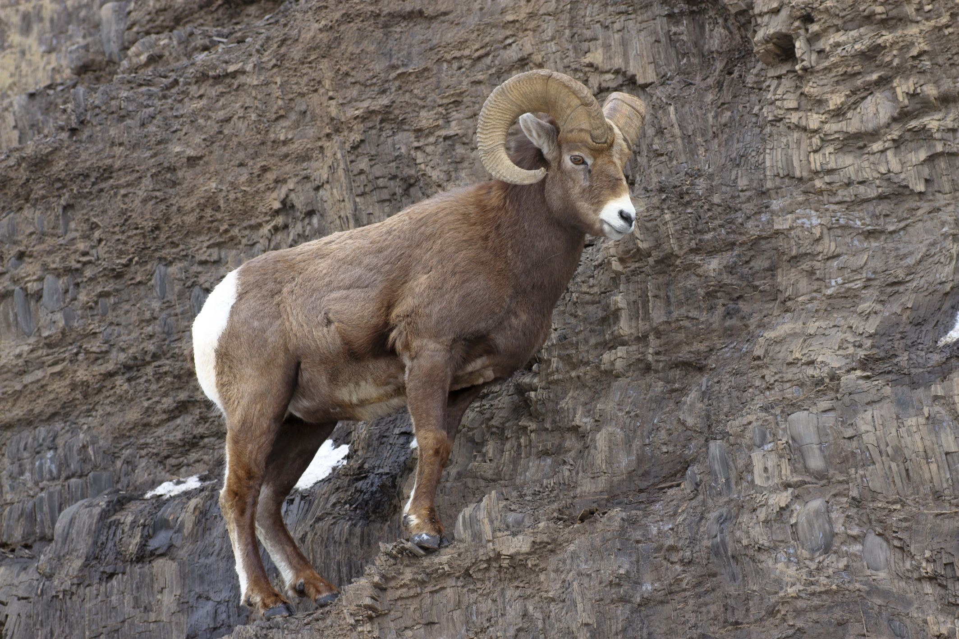


Case Study Activity with REAL DATA: RESULTS
Beginning of Slide Show
Part II
RESULTS
Copyright: The Wild Sheep Foundation and Bear Trust International 2013

Slide 2
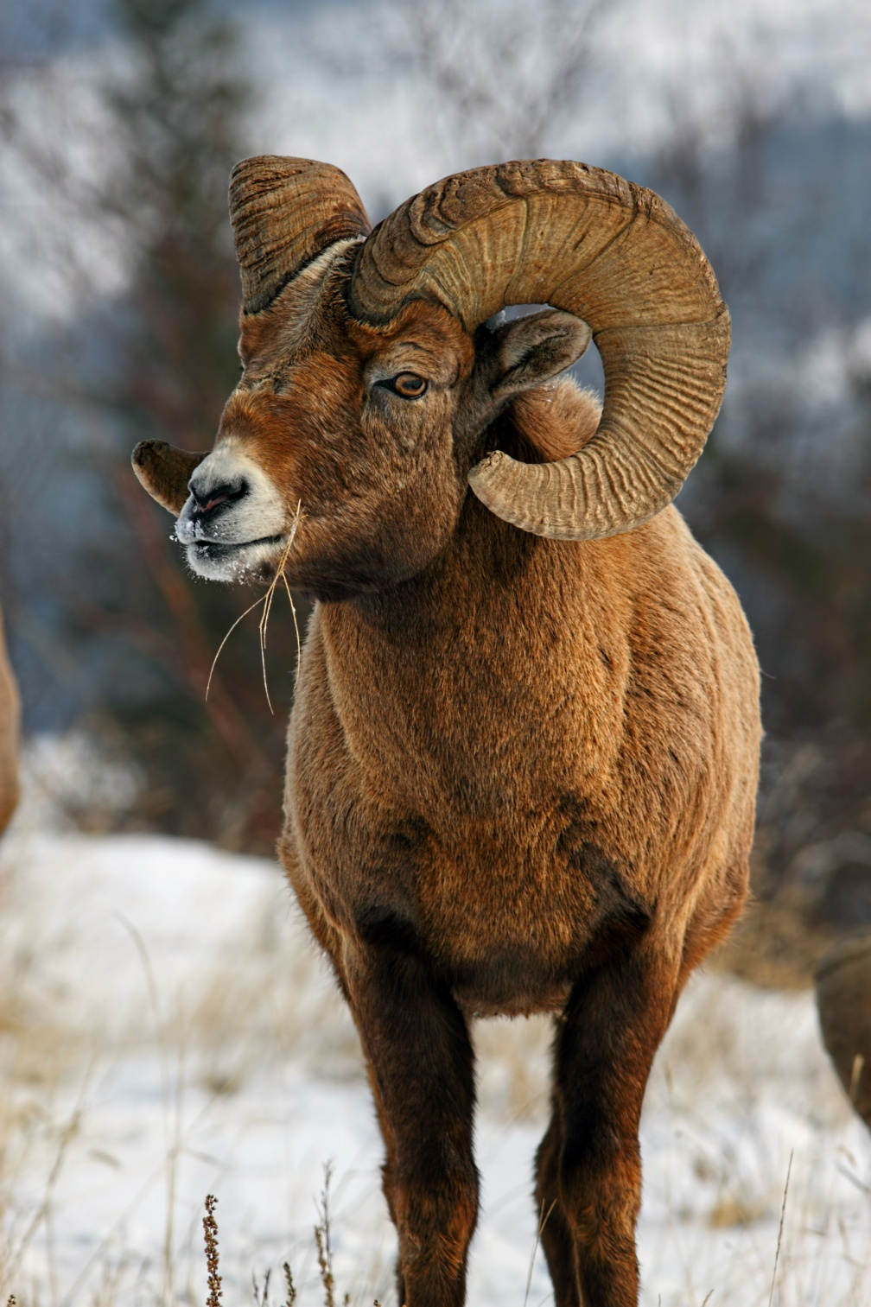
Case Study Activity with REAL DATA: RESULTS
Ready to see the RESULTS
that the bighorn sheep
scientists presented?
Let’s look at each CASE STUDY

Slide 3
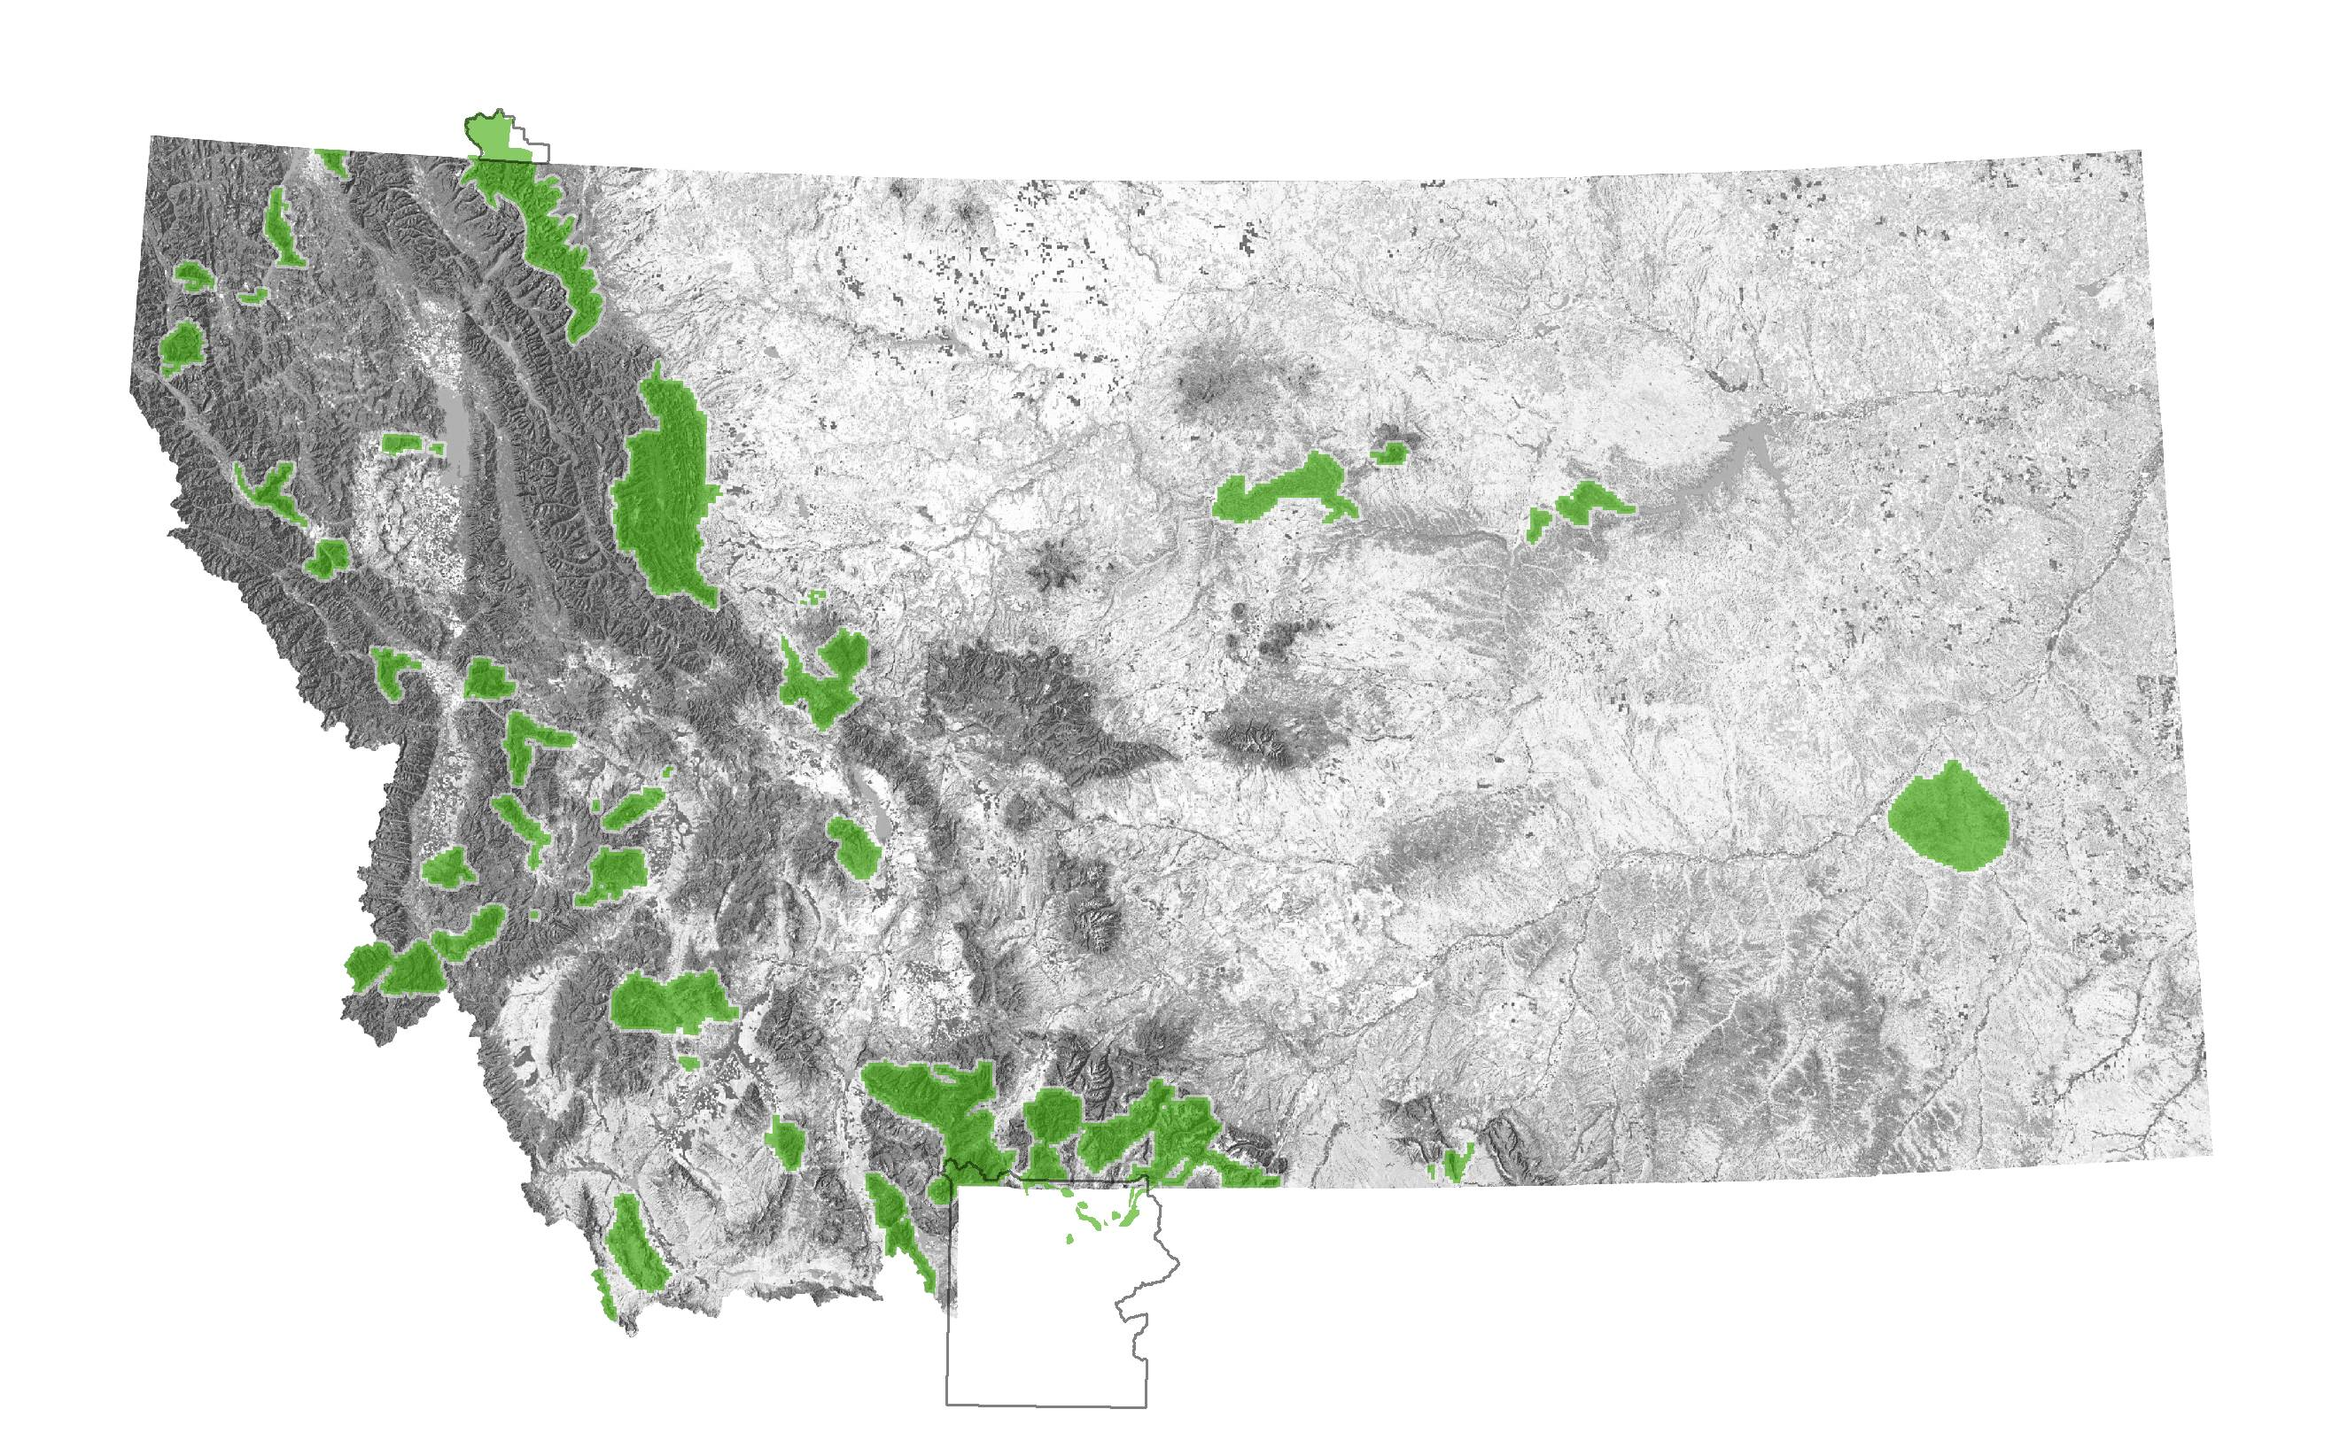
Case Study Activity with REAL DATA: RESULTS
GROUP 1: Thompson Falls bighorn sheep herd
Your POPULATION graph should look something like…….

Slide 4
Case Study Activity with REAL DATA: RESULTS
GROUP 1: Thompson Falls bighorn sheep herd
Your POPULATION graph should look something like…….
In 1959, this herd was re-established with 13 sheep that were trapped FROM another herd and transplanted TO the Thompson Falls habitat
Why has this herd been decreasing so much since 2008?
Number of bighorn sheep
Vehicle collisions and increased predation by mountain lions
Year

Slide 5
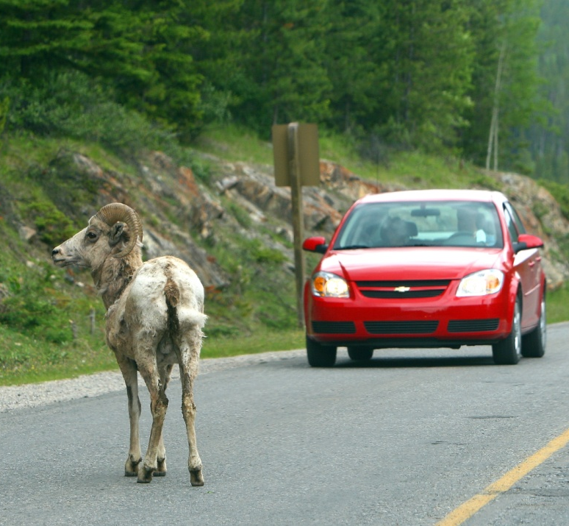
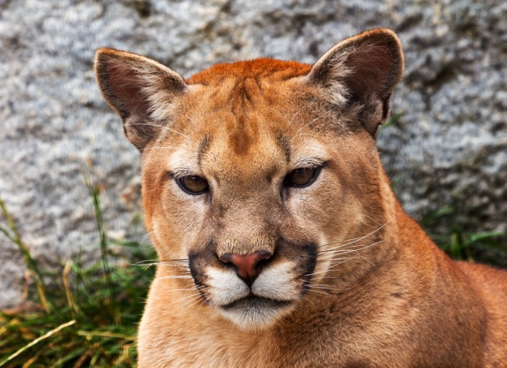
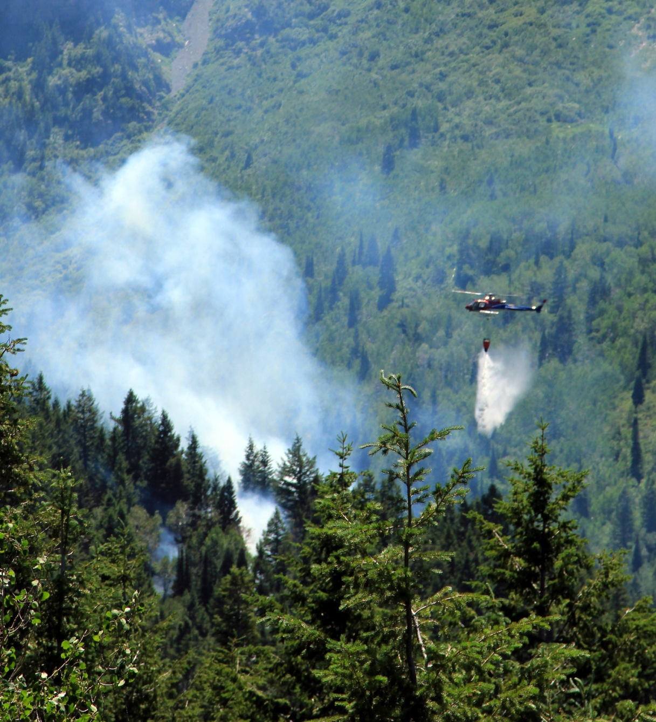
Case Study Activity with REAL DATA: RESULTS
This is the most important factor for this herd
GROUP 1: Thompson Falls bighorn sheep herd
What factors affect the conservation of this herd?
Habitat loss from fire
suppression and
conifer encroachment
Vehicles and trains
kill bighorn sheep
Mountain lion
predation

Slide 6
Case Study Activity with REAL DATA: RESULTS
GROUP 1: Thompson Falls bighorn sheep herd
What factors affect the conservation of this herd?
How many bighorn sheep have been killed by vehicles and trains since 1985?
461!
Vehicles and trains
kill bighorn sheep
Here’s what your graph of ANNUAL MORTALITIES
by vehicles and trains should look like:
Number of bighorn sheep killed
Year

Slide 7
Case Study Activity with REAL DATA: RESULTS
This factor is important for this herd, too
GROUP 1: Thompson Falls bighorn sheep herd
What factors affect the conservation of this herd?
Habitat loss from fire
suppression and
conifer encroachment
Vehicles and trains
kill bighorn sheep
Mountain lion
predation

Slide 8
Case Study Activity with REAL DATA: RESULTS
GROUP 1: Thompson Falls bighorn sheep herd
What factors affect the conservation of this herd?
Since 2008, mountain lions have become an increasing issue for this herd
Mountain lion
predation

Slide 9
Case Study Activity with REAL DATA: RESULTS
This factor is important for this herd, too
GROUP 1: Thompson Falls bighorn sheep herd
What factors affect the conservation of this herd?
Habitat loss from fire
suppression and
conifer encroachment
Vehicles and trains
kill bighorn sheep
Mountain lion
predation

Slide 10
Case Study Activity with REAL DATA: RESULTS
This factor is important for this herd, too
GROUP 1: Thompson Falls bighorn sheep herd
What factors affect the conservation of this herd?
Historically, wildfire was part of the landscape in this area
With the advent of fire suppression by the US Forest Service over the past 50 years, food resources like bunchgrass are slowly being replaced by encroaching Douglas fir trees
Habitat loss from fire
suppression and
conifer encroachment
Wildfire helped maintain fire-dependent vegetation communities like Ponderosa Pine trees and bunchgrasses
Bighorn sheep like to eat bunchgrasses
Bighorn sheep do NOT like to eat Douglas fir trees

Slide 11
Case Study Activity with REAL DATA: RESULTS
GROUP 2: Lost Creek bighorn sheep herd
Your graph should look something like…..

Slide 12
Case Study Activity with REAL DATA: RESULTS
GROUP 2: Lost Creek bighorn sheep herd
What happened in the fall of 1991 to make the number of bighorn sheep decrease so much?
Your graph should look something like…..
In 1967, this herd was re-established with 25 sheep that were trapped FROM another herd and transplanted TO the Lost Creek habitat
A pneumonia outbreak caused
a die-off
How did bighorn sheep in this herd get pneumonia?
Number of bighorn sheep
It was transmitted from domestic sheep
Do you think this herd has rebounded since the die-off in 1991?
Year
No data 2002-2005

Slide 13
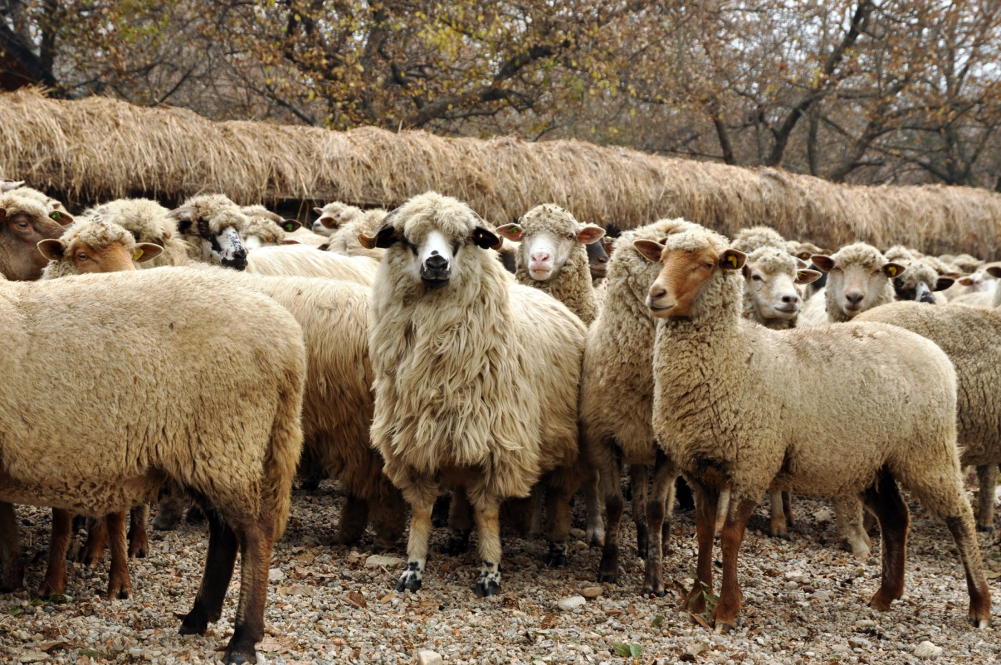
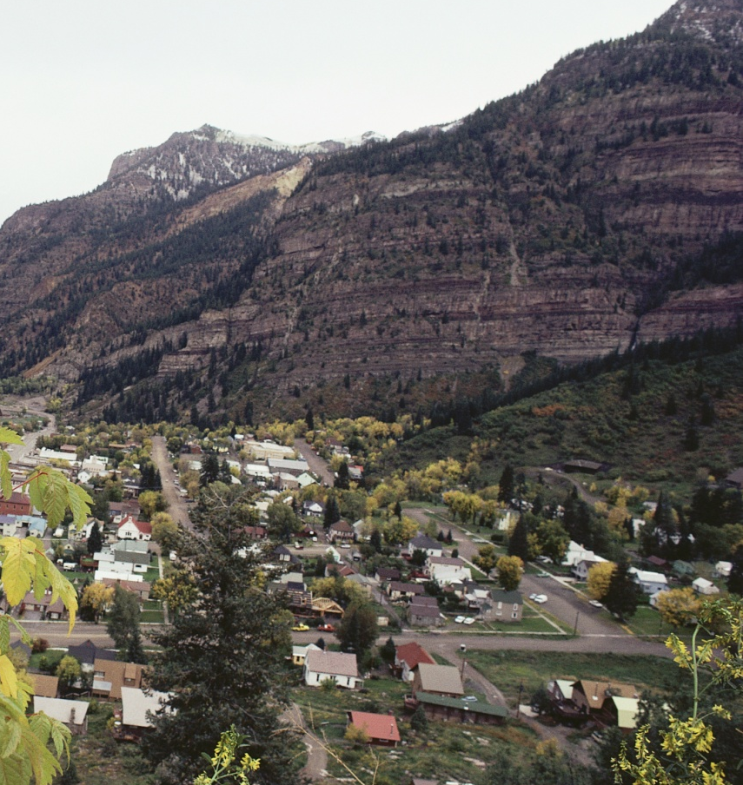
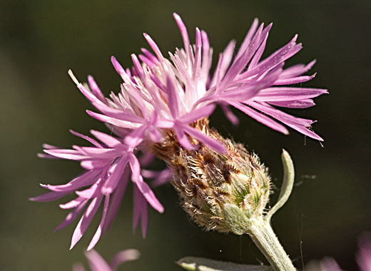
Case Study Activity with REAL DATA: RESULTS
This is the most important factor for this herd
GROUP 2: Lost Creek bighorn sheep herd
What factors affect the conservation of this herd?
Disease transmission from domestic sheep and goats
Habitat loss due to
human development
Habitat loss due
to weeds

Slide 14
Case Study Activity with REAL DATA: RESULTS
GROUP 2: Lost Creek bighorn sheep herd
What factors affect the conservation of this herd?
Bighorn sheep are VERY susceptible to pneumonia
Disease transmission from domestic sheep and goats
When a bighorn sheep herd is infected with pneumonia, it can kill rams, ewes, and lambs
Any sheep in the herd that survive a pneumonia outbreak become disease carriers……
……infecting new lambs in the following years
Biologically, bighorn sheep already have a LOW RATE OF REPRODUCTION (ewes only give birth to 1 or sometimes 2 lambs/year)
So for some herds, it can take a really long time to recover from a pneumonia outbreak (and some herds never recover)

Slide 15
Case Study Activity with REAL DATA: RESULTS
GROUP 2: Lost Creek bighorn sheep herd
What factors affect the conservation of this herd?
Disease transmission from domestic sheep and goats
Through a lot of research, scientists have discovered that wild bighorn sheep herds that have pneumonia often contract it from domestic sheep and goat herds
Scientists now recommend that wild bighorn sheep herds need to be at least 17.5 miles away from domestic sheep and goats to minimize disease transmission; at this distance wild sheep and domestic animals are less likely to interact.

Slide 16
Case Study Activity with REAL DATA: RESULTS
GROUP 2: Lost Creek bighorn sheep herd
This factor is also important to this herd
What factors affect the conservation of this herd?
Disease transmission from domestic sheep and goats
Habitat loss due to
human development
Habitat loss due
to weeds

Slide 17
Case Study Activity with REAL DATA: RESULTS
GROUP 2: Lost Creek bighorn sheep herd
What factors affect the conservation of this herd?
Habitat loss due to
human development
Human development like subdivisions…..
…..is reducing winter range and lambing areas for this herd

Slide 18
Case Study Activity with REAL DATA: RESULTS
GROUP 2: Lost Creek bighorn sheep herd
This factor is also important to this herd
What factors affect the conservation of this herd?
Disease transmission from domestic sheep and goats
Habitat loss due to
human development
Habitat loss due
to weeds

Slide 19
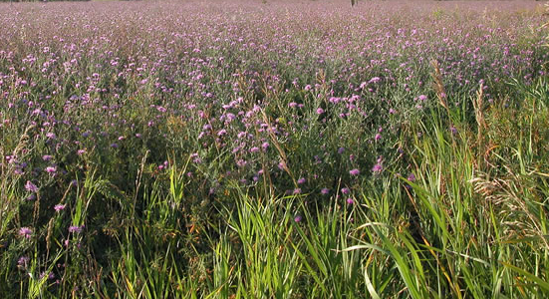
Case Study Activity with REAL DATA: RESULTS
GROUP 2: Lost Creek bighorn sheep herd
What factors affect the conservation of this herd?
Weed infestations are becoming an increasing problem for many wild animal species
Habitat loss due
to weeds
Weeds like spotted knapweed choke out fields of native vegetation, including many grasses used as food by bighorn sheep

Slide 20
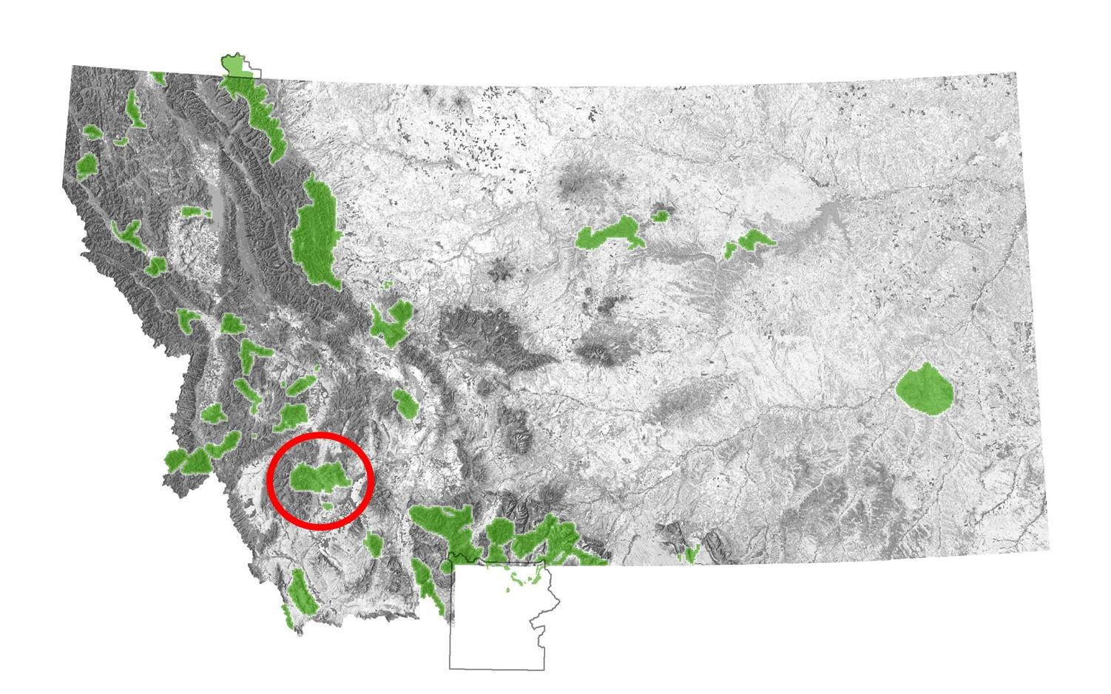
Case Study Activity with REAL DATA: RESULTS
GROUP 3: Highland bighorn sheep herd
Your graph should look something like…..

Slide 21
Case Study Activity with REAL DATA: RESULTS
GROUP 3: Highland bighorn sheep herd
Your graph should look something like…..
What happened in late 1994 to make the number of bighorn sheep decrease ?
In the late 1960s, this herd was re- established with 53 sheep that were trapped FROM another herd and transplanted TO the Highland habitat
A pneumonia outbreak caused
a die-off
What percentage of sheep were killed?
90%
Number of bighorn sheep
After the die-off, what did managers do to try and help this herd?
Do you think this herd has rebounded since the die-off in 1994?
They transplanted 66 sheep FROM the Southern Rocky Mountain front herd TO the Highland herd
Year
No data 1999-2004

Slide 22
Case Study Activity with REAL DATA: RESULTS
GROUP 3: Highland bighorn sheep herd
What factors affect the conservation of this herd?
Disease transmission from domestic sheep and goats
The die-off that occurred in the Highland bighorn sheep herd in 1994 was caused by pneumonia that was transmitted to wild sheep by domestic sheep
This is the major factor affecting this bighorn sheep herd

Slide 23
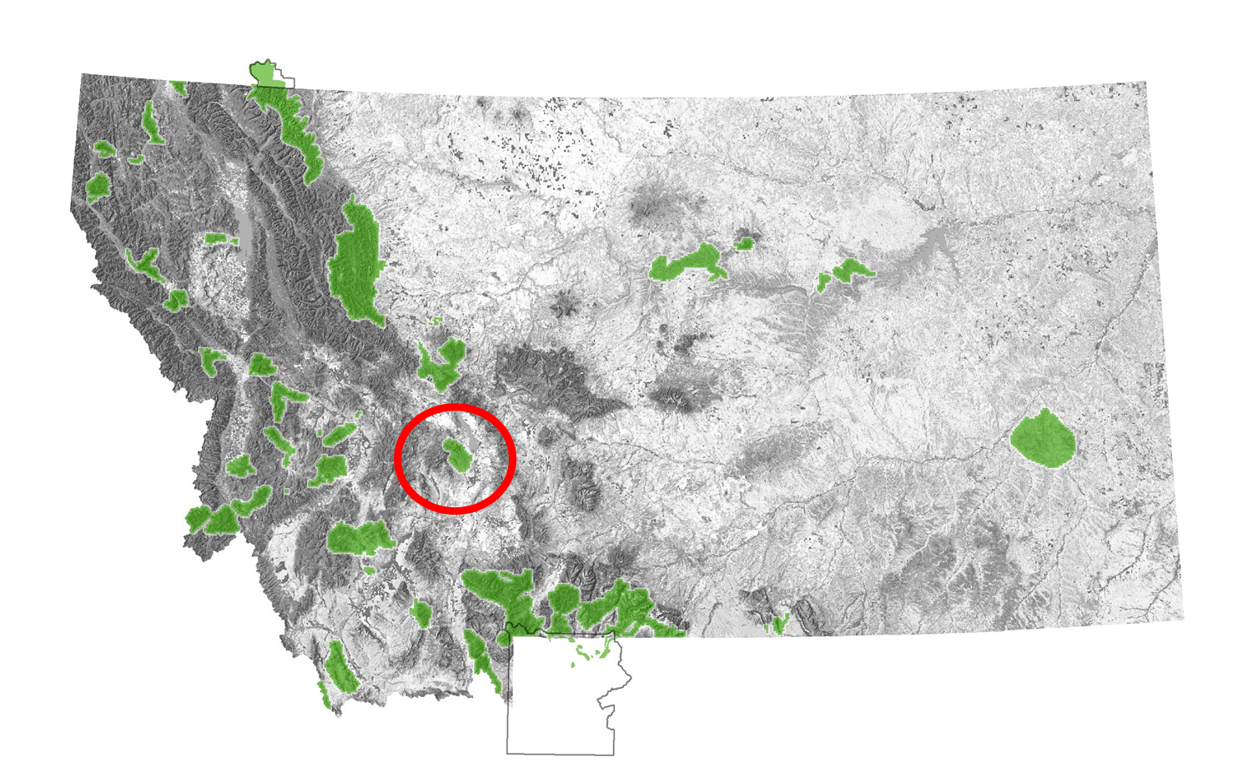
Case Study Activity with REAL DATA: RESULTS
GROUP 4: Elkhorn bighorn sheep herd
Your graph should look something like…….

Slide 24
Case Study Activity with REAL DATA: RESULTS
GROUP 4: Elkhorn bighorn sheep herd
Your graph should look something like…….
What happened in early 2008 to make the number of bighorn sheep decrease?
In 1995-2000, this herd was re-established with 75 sheep that were trapped FROM another herd and transplanted TO the Elkhorn habitat
A pneumonia outbreak caused
a die-off
Number of bighorn sheep
Do you think that this herd has rebounded since the die-off in 2008?
What percentage of sheep were killed?
90%
Year

Slide 25
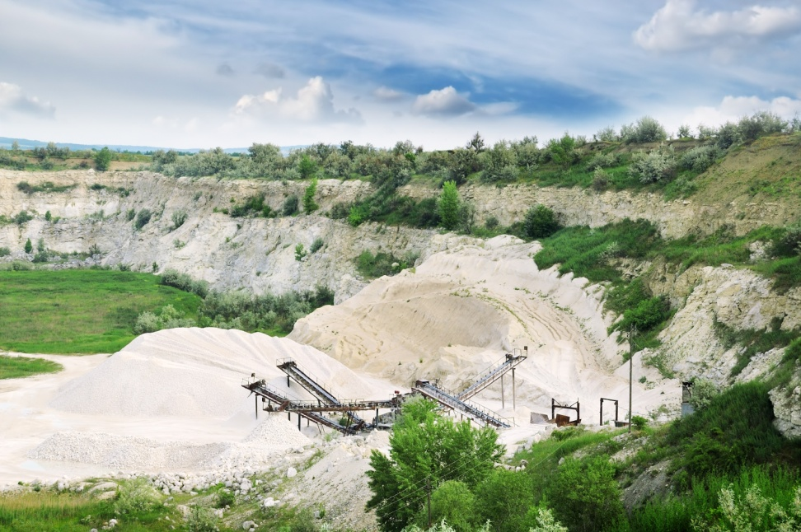
Case Study Activity with REAL DATA: RESULTS
GROUP 4: Elkhorn bighorn sheep herd
This is the most important factor for this herd
What factors affect the conservation of this herd?
Disease transmission from domestic sheep and goats
Loss of habitat due to human
development including mining
The pneumonia outbreak that caused the die-off in 2008 was transmitted to Elkhorn bighorn sheep from domestic sheep

Slide 26
Case Study Activity with REAL DATA: RESULTS
GROUP 4: Elkhorn bighorn sheep herd
This factor is also important to this herd
What factors affect the conservation of this herd?
Disease transmission from domestic sheep and goats
Loss of habitat due to human
development including mining
Mining activity from limestone quarries are reducing winter bighorn sheep habitat

Slide 27
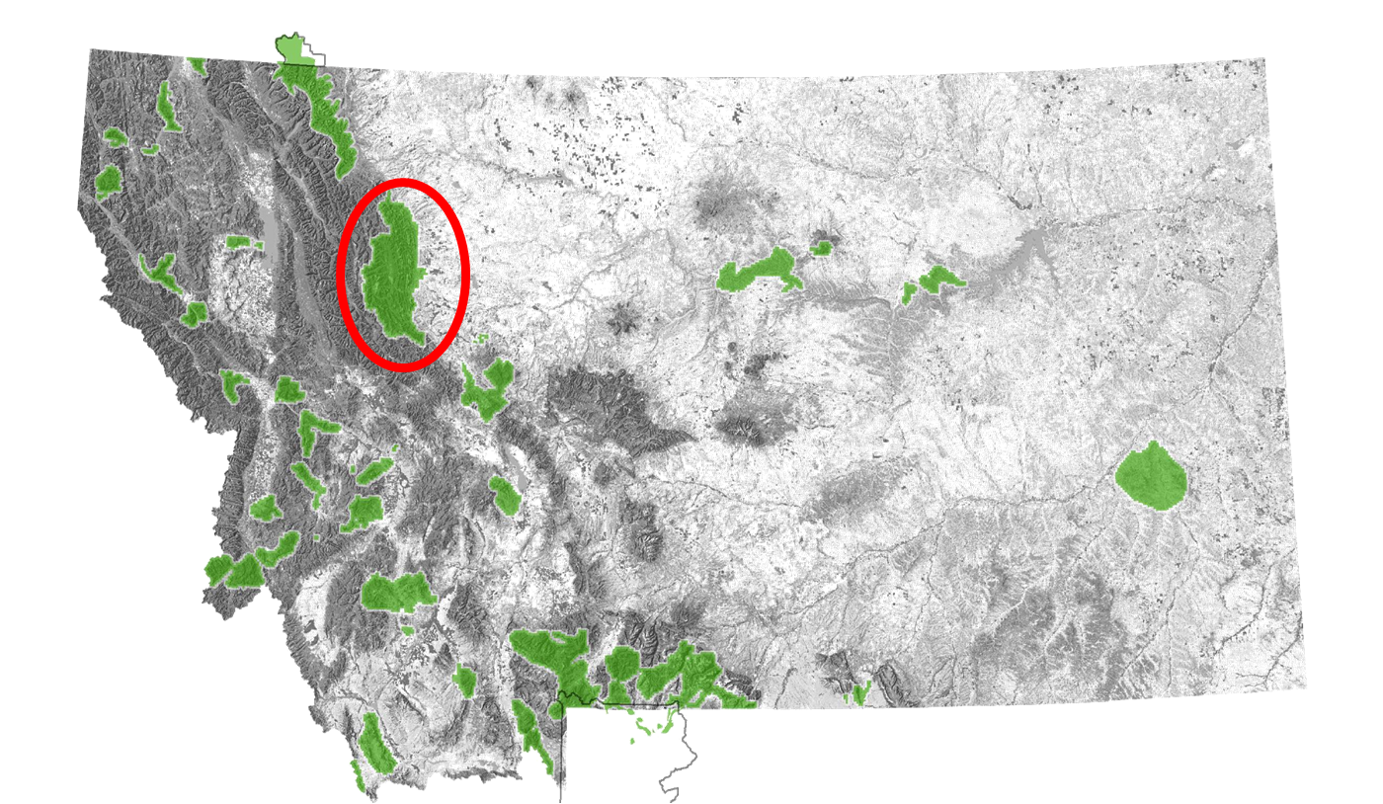
Case Study Activity with REAL DATA: RESULTS
GROUP 5: Southern Rocky Mountain Front sheep herd
Your graph should look something like…….

Slide 28
Case Study Activity with REAL DATA: RESULTS
GROUP 5: Southern Rocky Mountain Front sheep herd
Your graph should look something like…….
Historically, this herd has done pretty well.
In fact, biologists have trapped bighorn sheep FROM this herd and transplanted them TO other herds 52 times!
For example, in 1967….. 25 sheep were trapped FROM this herd and transplanted to re-establish the Lost Creek herd
Number of bighorn sheep
In the late 1960s, 53 sheep were trapped FROM this herd and transplanted to re-establish the Highland herd
And in 2000, 32 sheep were trapped FROM this herd and transplanted to the Highland herd to try and help after the die-off

Slide 29
Case Study Activity with REAL DATA: RESULTS
GROUP 5: Southern Rocky Mountain Front sheep herd
Your graph should look something like…….
The exact cause of the die-off in 2009 is currently under scientific investigation, but so far it appears that the die-off was due to pneumonia
Recently, another die-off occurred in summer 2010
Number of bighorn sheep
What happened in early 1983?
Do you think that this herd recovered from the die-off
that occurred in 1983?
A die-off

Slide 30
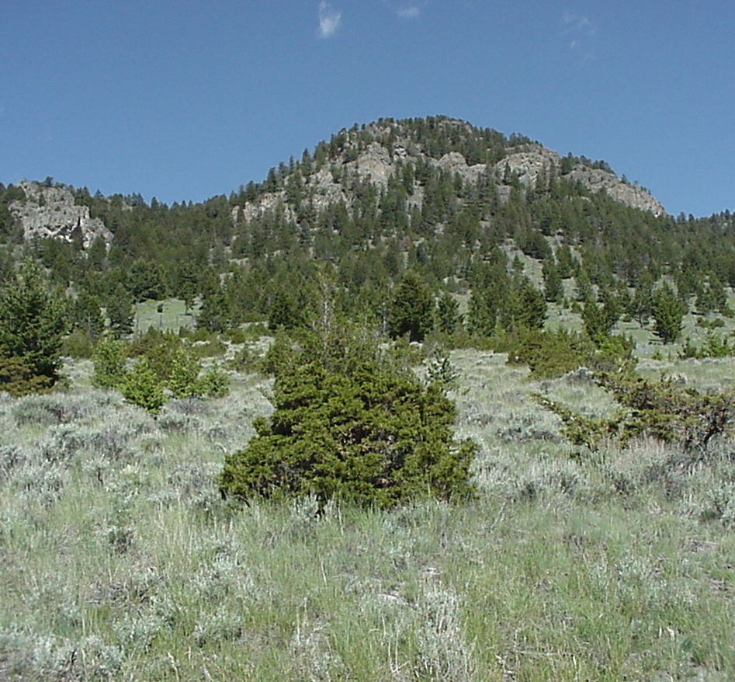
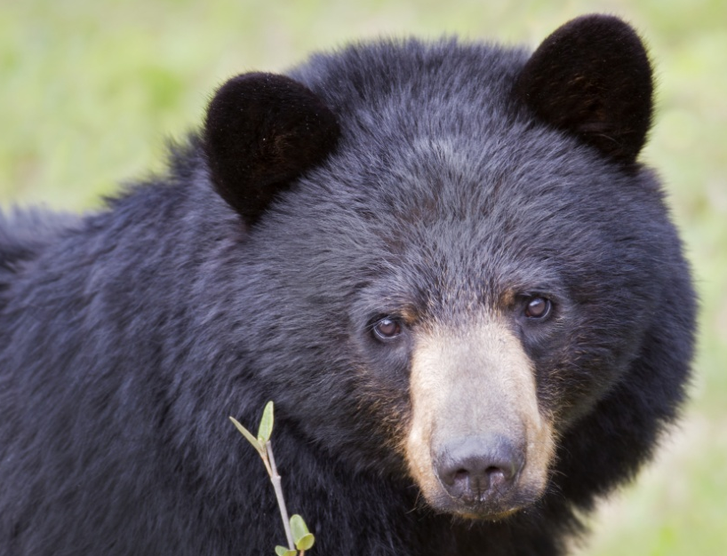
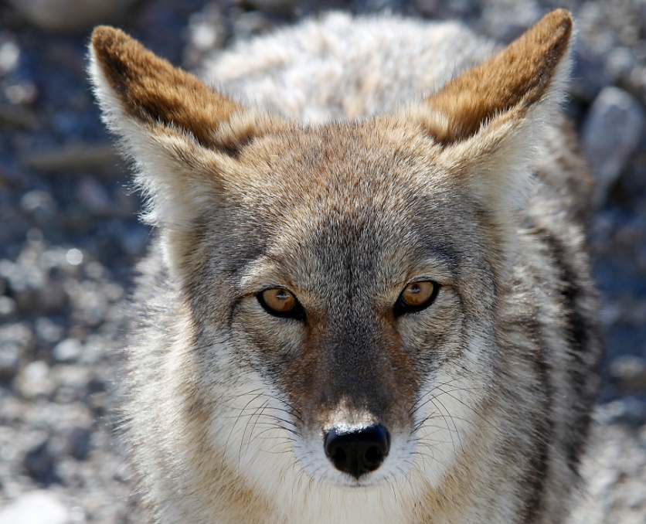

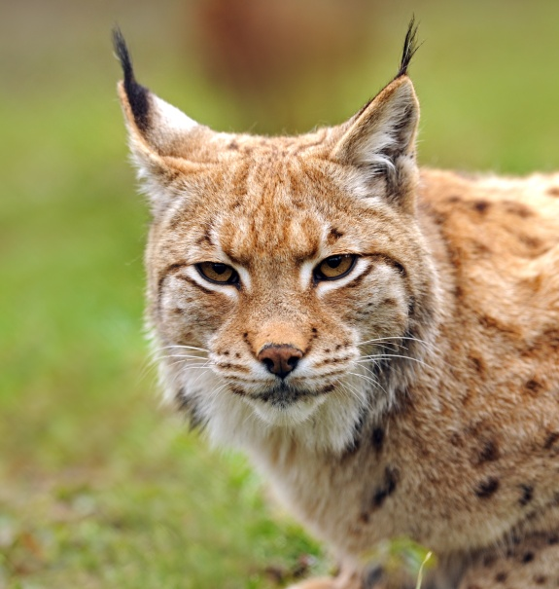
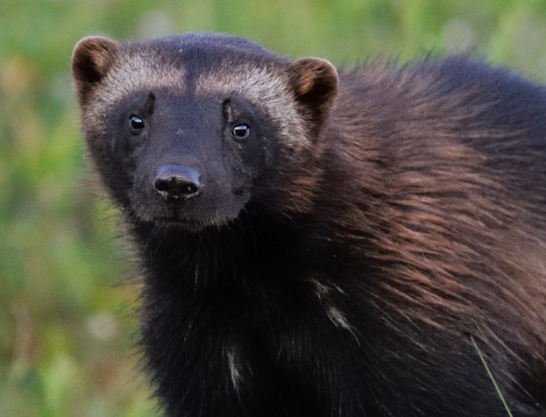
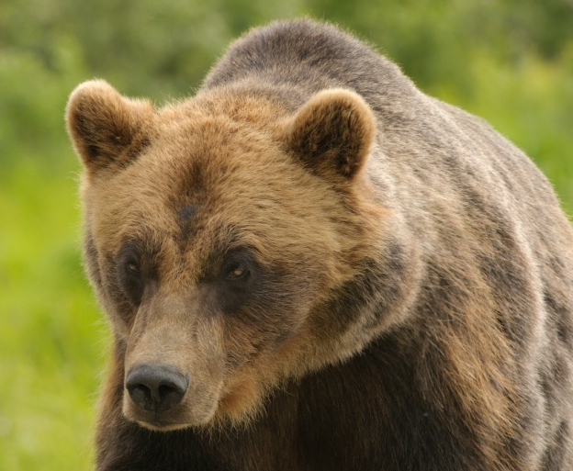
Case Study Activity with REAL DATA: RESULTS
Let’s look at this one first
GROUP 5: Southern Rocky Mountain Front sheep herd
What factors affect the conservation of this herd?
Maintaining high
quality habitat
Disease transmission from domestic sheep and goats
Predators?

Slide 31
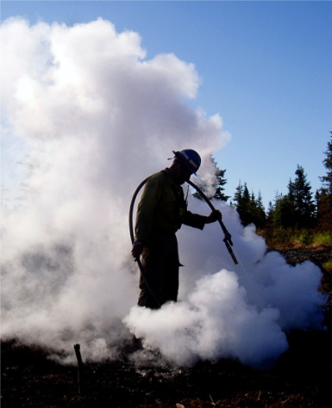
Case Study Activity with REAL DATA: RESULTS
GROUP 5: Southern Rocky Mountain Front sheep herd
What factors affect the conservation of this herd?
Maintaining high
quality habitat
In part because of fire suppression….
…..conifer encroachment
can be an issue for wild
bighorn sheep habitat in
this area
So bighorn sheep managers
collaborate with the US
Forest Service on
habitat manipulation….
…..like prescribed burning

Slide 32
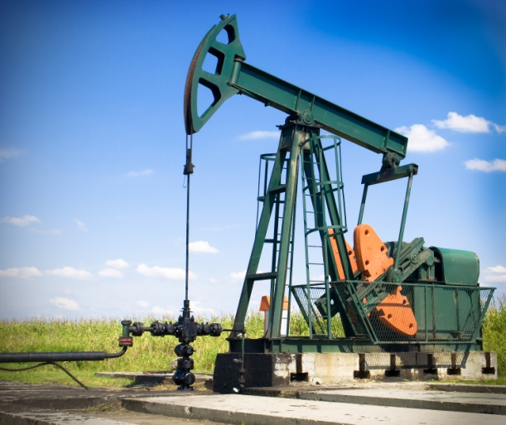
Case Study Activity with REAL DATA: RESULTS
GROUP 5: Southern Rocky Mountain Front sheep herd
What factors affect the conservation of this herd?
Maintaining high
quality habitat
There are other things that affect habitat quality.
For example……..
…...oil and gas exploration was a possibility
that COULD HAVE affected habitat quality here
Very recently, this situation was resolved.
There will be no gas or oil exploration in
the Rocky Mountain Front
How do you think gas or oil exploration might affect the habitat quality for wild bighorn sheep?

Slide 33
Case Study Activity with REAL DATA: RESULTS
Let’s look at this one next
GROUP 5: Southern Rocky Mountain Front sheep herd
What factors affect the conservation of this herd?
Maintaining high
quality habitat
Disease transmission from domestic sheep and goats
Predators?

Slide 34
Case Study Activity with REAL DATA: RESULTS
GROUP 5: Southern Rocky Mountain Front sheep herd
What factors affect the conservation of this herd?
Until 2009, this wasn’t much
of a concern because there
are very few domestic sheep
farms near this wild bighorn sheep herd.
Disease transmission from domestic sheep and goats
But, given that the 2009 die-off
appears to have been caused
by pneumonia, minimizing disease transfer from domestic sheep to wild sheep is a potential concern

Slide 35
Case Study Activity with REAL DATA: RESULTS
GROUP 5: Southern Rocky Mountain Front sheep herd
Time for this one
What factors affect the conservation of this herd?
Maintaining high
quality habitat
Disease transmission from domestic sheep and goats
Predators?

Slide 36
Case Study Activity with REAL DATA: RESULTS
GROUP 5: Southern Rocky Mountain Front sheep herd
What factors affect the conservation of this herd?
This region has a strong predator presence, so it is likely that bighorn sheep survival could be or is affected by predators.
Predators?
BUT! No research has tested this hypothesis yet….

Slide 37
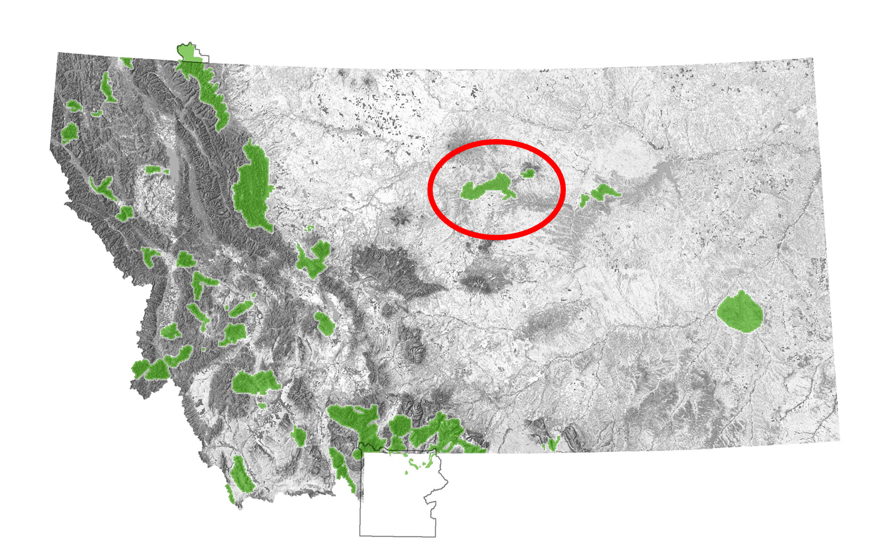
Case Study Activity with REAL DATA: RESULTS
GROUP 6: Missouri River Breaks bighorn sheep herd
Your graph should look something like……

Slide 38
Case Study Activity with REAL DATA: RESULTS
GROUP 6: Missouri River Breaks bighorn sheep herd
In 1980, this herd was
re-established with 28 sheep that were trapped FROM another herd and transplanted TO the Missouri River Breaks habitat
Your graph should look something like……
Why has the number of observed bighorn sheep been dropping since 2009?
Managers do not know for sure, but there were harsh winters in 2009-2010 and 2010-2011 which likely contributed to the decline
Why was the number of observed bighorn sheep so low in 2003?
Number of bighorn sheep
Only a portion of the area was surveyed due to mechanical problems with the helicopter
So, do you think the estimate
in 2003 is accurate?
Year

Slide 39
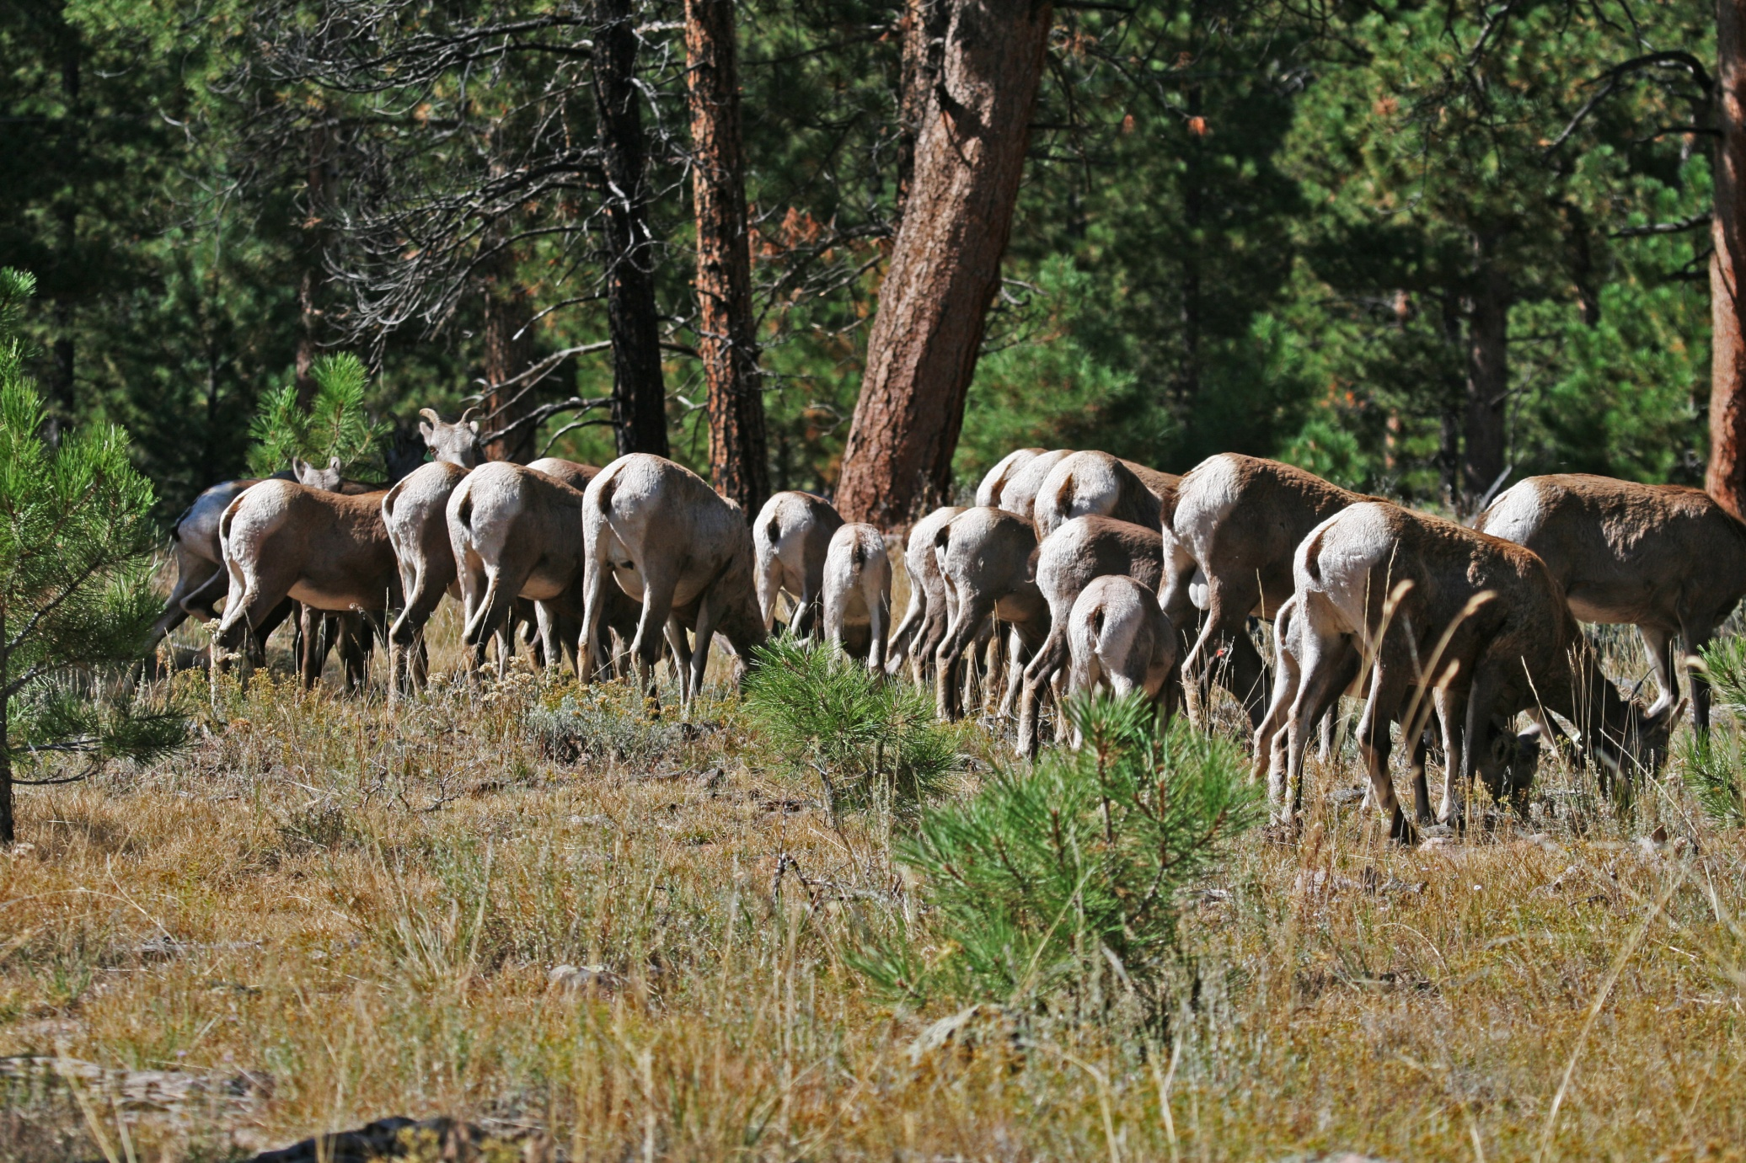
Case Study Activity with REAL DATA: RESULTS
GROUP 6: Missouri River Breaks bighorn sheep herd
What factors affect the conservation of this herd?
This bighorn sheep herd is doing relatively well
BUT! There IS at least one conservation factor……
…….keeping this herd at or below carrying capacity

Slide 40
Case Study Activity with REAL DATA: RESULTS
GROUP 6: Missouri River Breaks bighorn sheep herd
What factors affect the conservation of this herd?
When a population is at carrying capacity, the # of births = # deaths
It’s the maximum size of a population that the environment can sustain indefinitely without degrading the environment for future generations
What does carrying capacity mean?
…….keeping this herd at or below carrying capacity

Slide 41
Case Study Activity with REAL DATA: RESULTS
GROUP 6: Missouri River Breaks bighorn sheep herd
What factors affect the conservation of this herd?
Why do managers want to keep this herd at or below carrying capacity?
To reduce the risk of die-offs from disease transmission from domestic sheep and goats and to minimize habitat degradation
When populations are at high densities, the risk of transmitting diseases (like pneumonia) among individuals in the population is relatively HIGH

Slide 42
Case Study Activity with REAL DATA: RESULTS
GROUP 6: Missouri River Breaks bighorn sheep herd
What factors affect the conservation of this herd?
How do managers maintain herds at or below carrying capacity?
1. They trap some individuals and transplant them to other herds
They use regulated hunting to help keep the population healthy
(regulated hunting is an important conservation tool)
Now let’s take a look at a different aspect of populations….

Slide 43
Case Study Activity with REAL DATA: RESULTS
Minimum Viable Population (MVP)
What does Minimum Viable Population (MVP) mean?
The smallest possible size at which a biological population can persist without facing extinction
What is the MVP for bighorn sheep populations in Montana?
125 individuals
How many of the 6 herds are currently below MVP?
Let’s take a look!

Slide 44
Case Study Activity with REAL DATA: RESULTS
The dotted yellow lines represent MVP values (125 individuals)
Thompson Falls
Elkhorn
What do you think these results indicate about the future of bighorn sheep in Montana?
Lost Creek
S. Rocky Mnt Front
How many herds are borderline?
2012
Highland
How many herds are currently below MVP?
Missouri River Breaks
2012

Slide 45
Case Study Activity with REAL DATA: RESULTS
Let’s look at the FACTORS that affect conservation of bighorn sheep
based on the combined results from your CASE STUDIES:
1. Disease transmission from domestic sheep and goats
Habitat loss due to fire suppression and subsequent conifer encroachment
(Maintaining high quality habitat)
Habitat loss due to human development, including subdivisions
and mining activity
4. Habitat loss due to noxious weeds
5. Road kill
6. Predators
7. For healthy herds, keeping the population at or below carrying capacity

Slide 46
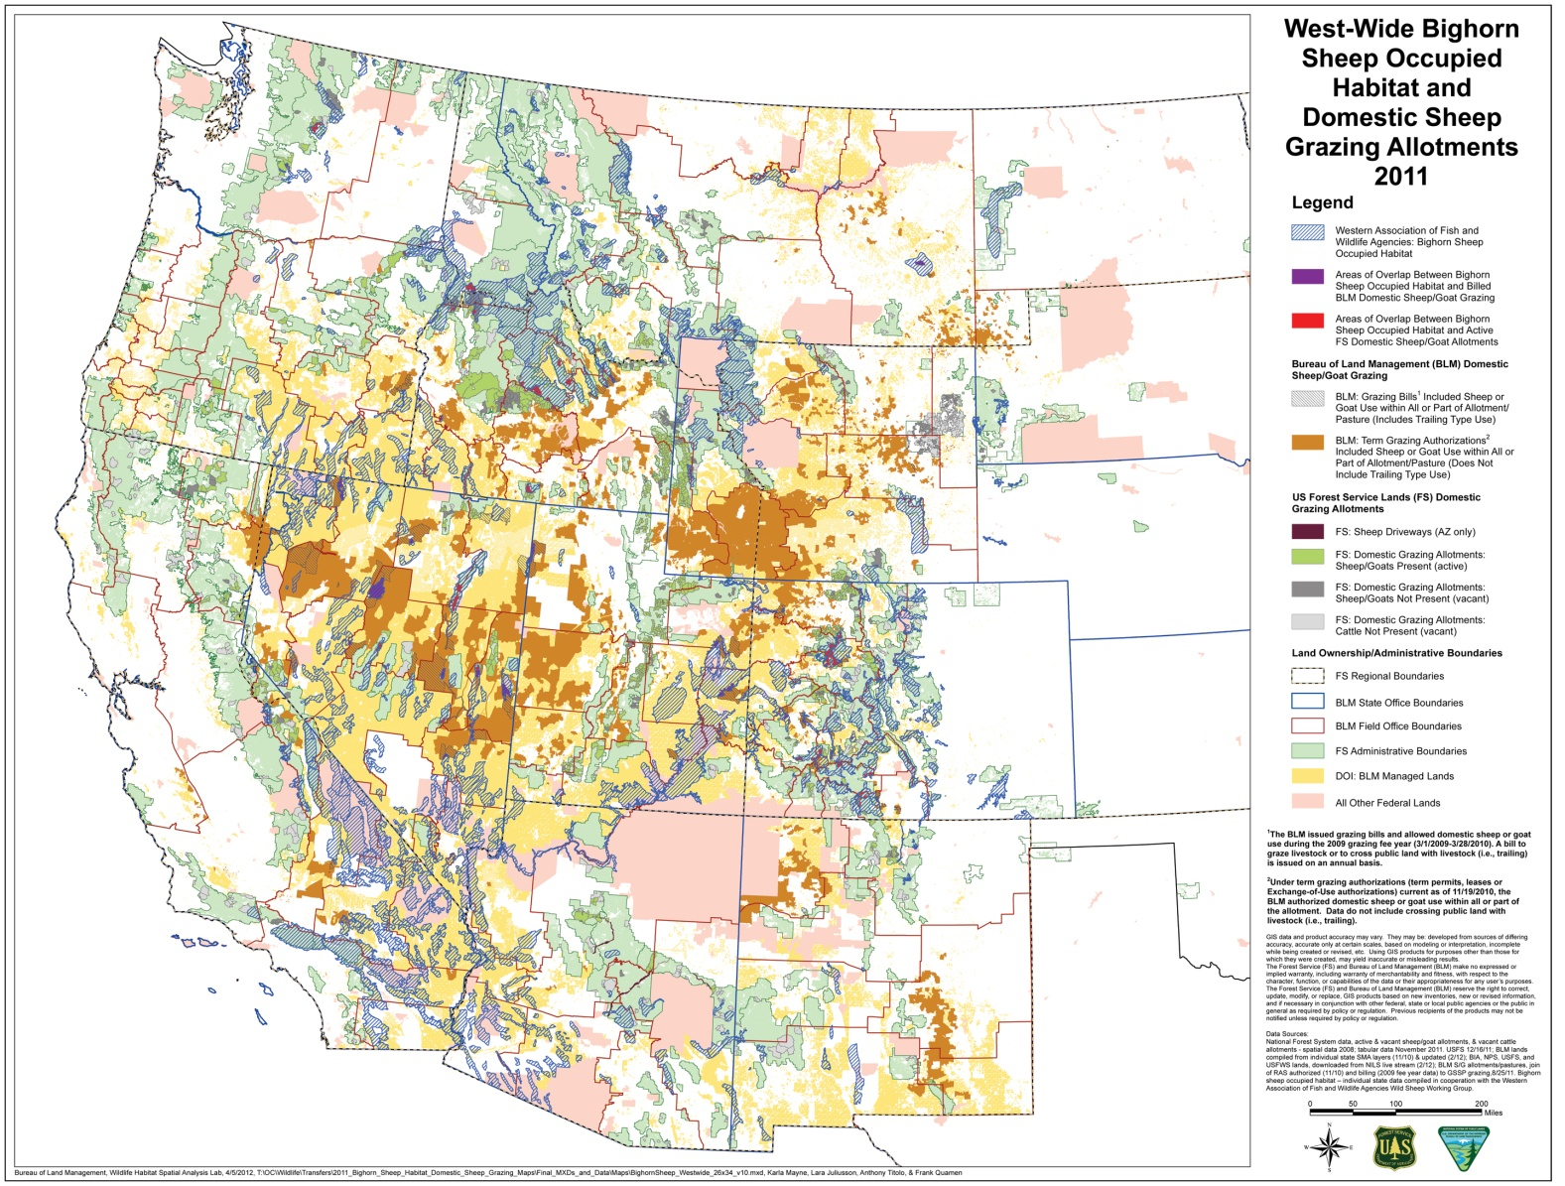
Case Study Activity with REAL DATA: RESULTS
Scientific groups like the Wild Sheep Working Group and hunting/conservation organizations like the Wild Sheep Foundation recognize this factor as one of the most important
Turns out, many factors that affect bighorn sheep in Montana are
the same factors that affect bighorn sheep throughout the West
Here’s the list of factors that affect bighorn sheep in the West:
1. Disease transmission from domestic sheep and goats
Washington
North Dakota
Montana
2. Habitat loss due to conifer encroachment and weeds
Oregon
Idaho
South Dakota
Wyoming
3. Predators
Nebraska
4. Habitat loss due to human development, including
subdivisions and mining activity
Nevada
Utah
Colorado
Arizona
New Mexico
5. Grazing competition with domestic and wild animals
Loss of connectivity among bighorn sheep herds , which is important to maintain
genetic diversity

Slide 47
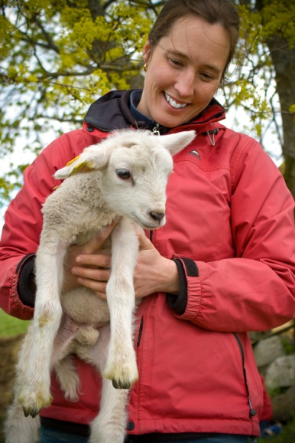
Case Study Activity with REAL DATA: RESULTS
Scientific groups like the Wild Sheep Working Group and hunting/conservation organizations like the Wild Sheep Foundation recognize this factor as one of the most important
Turns out, many factors that affect bighorn sheep in Montana are
the same factors that affect bighorn sheep throughout the West
Here’s the list of factors that affect bighorn sheep in the West:
1. Disease transmission from domestic sheep and goats
How do we manage bighorn sheep and landscapes to minimize this risk?
Remember: people who raise domestic sheep and goats have rights, too
We know that based on science, we should keep wild bighorn sheep at least 17.5 miles away from domestic sheep and goats to minimize the risk of disease transfer FROM domestic sheep and goats TO wild bighorn sheep

Slide 48
Case Study Activity with REAL DATA: RESULTS
Let’s look at 2 examples
Scientists, managers of bighorn sheep, and owners of domestic sheep and goats can WORK TOGETHER to find solutions
How can we do THAT?
We know that based on science, we should keep wild bighorn sheep at least 17.5 miles away from domestic sheep and goats to minimize the risk of disease transfer FROM domestic sheep and goats TO wild bighorn sheep

Slide 49

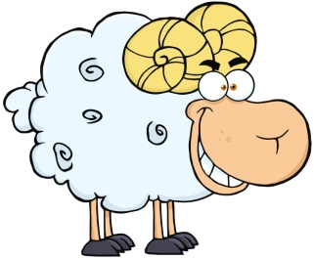
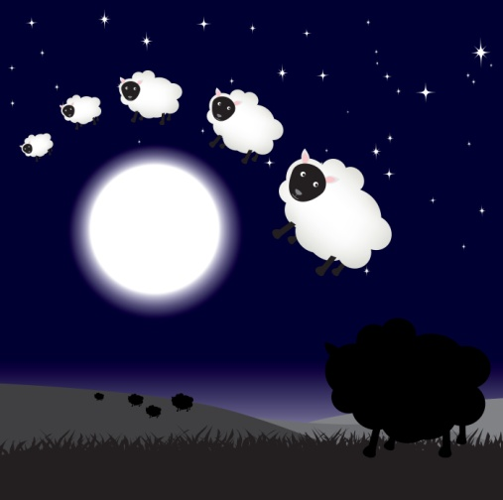

Case Study Activity with REAL DATA: RESULTS
Let’s look at 2 examples
Example 1: A Wyoming Strategy
Map of Wyoming
In western Wyoming, there were grazing allotments on federal lands that were used by domestic sheep
The problem was this: domestic grazing allotments in the western part of Wyoming were TOO CLOSE to existing herds of wild bighorn sheep
So, state wildlife managers and hunting organizations helped domestic sheep owners MOVE the domestic sheep FROM the western grazing allotments TO eastern grazing allotments

Slide 50
Case Study Activity with REAL DATA: RESULTS
Let’s look at 2 examples
Example 1: A Wyoming Strategy
Map of Wyoming
In western Wyoming, there were grazing allotments on federal lands that were used by domestic sheep
The problem was this: domestic grazing allotments in the western part of Wyoming were TOO CLOSE to existing herds of wild bighorn sheep
So, state wildlife managers and hunting organizations helped domestic sheep owners MOVE the domestic sheep FROM the western grazing allotments TO eastern grazing allotments
This collaborative solution helped maintain separation between wild bighorn sheep herds and domestic sheep herds

Slide 51
Case Study Activity with REAL DATA: RESULTS
Let’s look at 2 examples
Example 2: A Montana Strategy
Map of Montana
In north central Montana near the Missouri River Breaks bighorn sheep herd…….
….there was a domestic sheep farm that was TOO CLOSE to the wild bighorn sheep herd

Slide 52
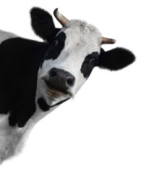
Case Study Activity with REAL DATA: RESULTS
Let’s look at 2 examples
Example 2: A Montana Strategy
Map of Montana
In north central Montana near the Missouri River Breaks bighorn sheep herd…….
….there was a domestic sheep farm that was TOO CLOSE to the wild bighorn sheep herd
So, the Montana Wild Sheep Foundation helped the domestic sheep farmer convert their operation FROM domestic sheep TO cattle. Cattle do not transfer pneumonia to wild bighorn sheep
This collaborative solution helped keep wild bighorn sheep away from domestic sheep AND helped ensure that the farmer could still make a living

Slide 53
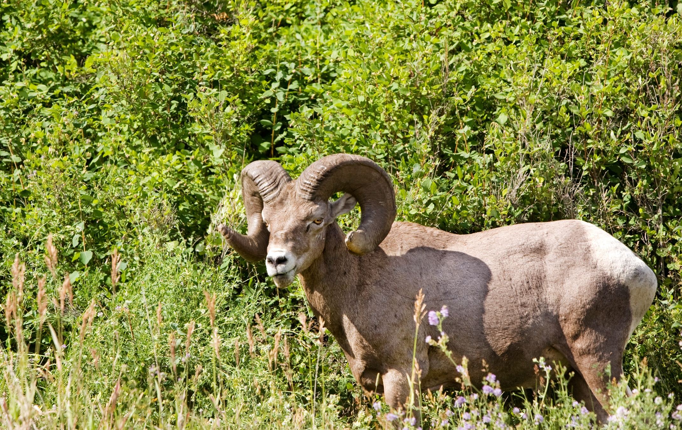
Case Study Activity with REAL DATA: RESULTS
Can you think of other ways that scientists, bighorn sheep managers, and domestic sheep farmers can work together to ensure the future of bighorn sheep is not on the edge?

Slide 54
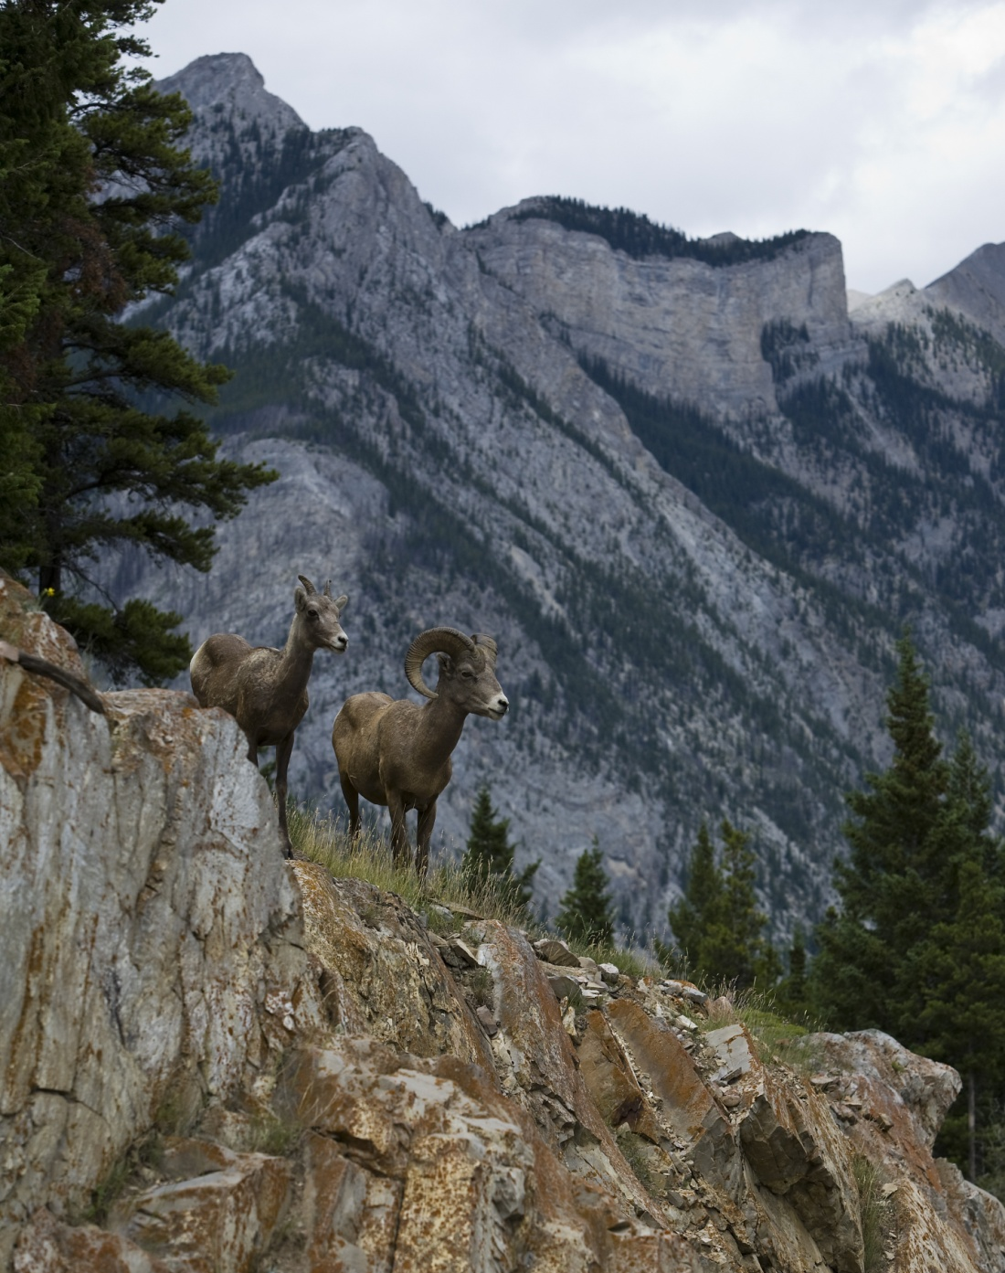
Conclusion
Thank you for participating
in this activity!
Look for the following new
lessons soon:
1. How many domestic sheep grazing
allotments are 17.5 miles away from
wild bighorn sheep herds ?
(use real spatial data to evaluate)
2. How far do bighorn rams and ewes
travel and what habitats do they use?
(use real GPS locations for bighorns)

